Slide 1

CMR COLLEGE OF ENGINEERING & TECHNOLOGY
Kandlakoya, Medchal, Hyderabad - 501401
Department of Computer Science and Engineering
HEALTHY CROP
BATCH - 33
20H51A0575-S.YASHWANT
20H51A0563-D.HONEY KEZIA
20H51A05N7- VINAYASWI REDDY
Under esteemed guidance of
Ms. M KAMALA
Associate Professor

Slide 2
Outline
Abstract
Introduction
Literature survey
Existed system
- Problems in existed system
Research Objective
Problem Definition
Research work
- Proposed system architecture
- Requirement analysis
Results
Conclusion
Future Work
References
Notes:
2

Slide 3
Abstract
Notes:
3

Slide 4
ABSTRACT
Agriculture is the science and art of producing crops and livestock for economic purpose. Farmer is the one who will raise crops to market for consumption, medical use, animal food production and the growing herbal industry. Crop selection plays a vital role in crop production. Usually crop cultivation was undertaken on the basis of farmers hands-on expertise. Farmers are unable to choose the right crop based on soil, season and water level availability, and the process of manually predicting the choice of the right crop of land has, more often than not, resulted in failure. Accurate crop selection results in increased crop production. So, the project’s aim is to develop an platform i.e. website where farmers can select a suitable crop for his land in an effortless manner.

Slide 5
INTRODUCTION
Notes:
5

Slide 6
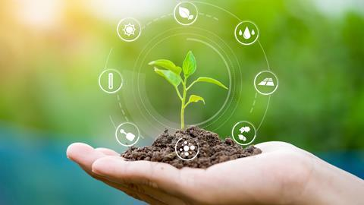
Introduction
In agriculture, crop prediction is the key factor. Usually, farmers select their crop based on their knowledge or other farmers advice, which may result in failure of suitable crop selection for their land. So, in order to help farmers in crop prediction, we as a team came up with effortless crop selection website where farmers can select the appropriate crop for their land.
Notes:
6

Slide 7
Literature Survey
Notes:
7

Slide 8
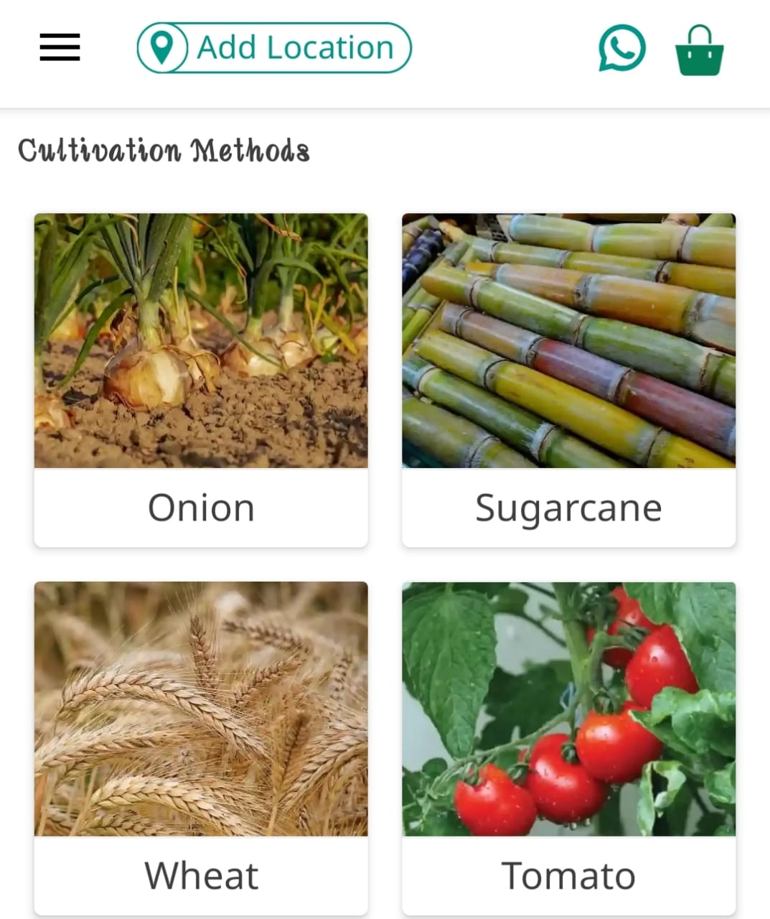
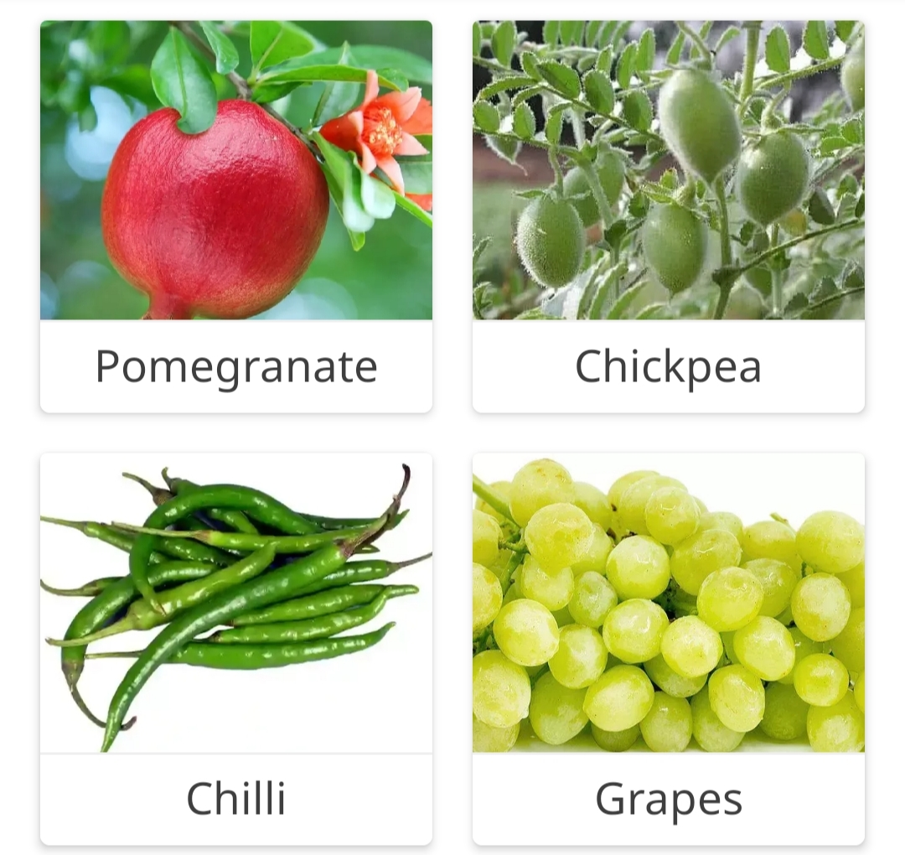
Existed system
BharatAgri: Smart Kisaan App
It is one of the apps which helps the farmers to get the complete information related to any crop under the cultivation methods section.
GAPS:
In order to access all features of app farmers have to pay amount.
There is no option in app where farmers can select the crop by some criteria(pH, season, water, soil type).
Notes:
8

Slide 9
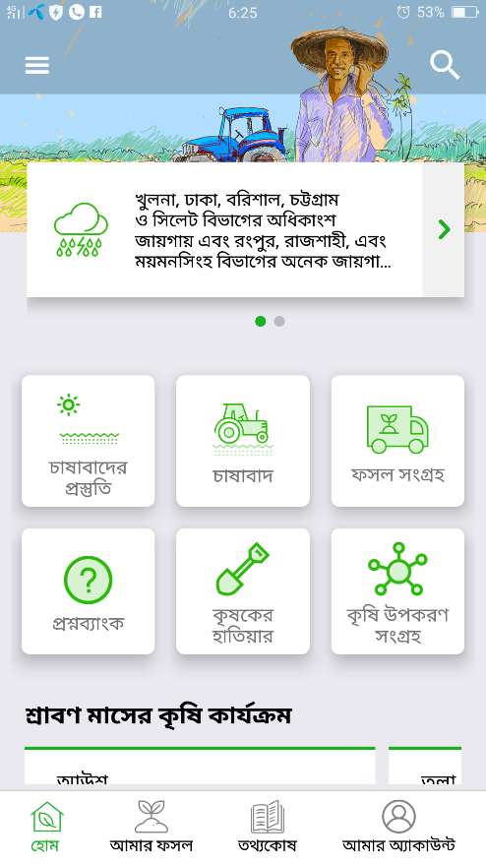
FOSHOLI : BEST AGRICULTURAL APP
The app, named Fosholi , provides information on growth suitability, the stages of growth, pest and disease risks and lastly profit & loss of (rice) plantations, Weather Forecast.
GAPS:
This app is available only in Bengali(Bangla) Language
It doesn’t mention any information regarding pH of the soil and what crops to be grown in a particular soil.
People who don’t understand Bengali language can’t use this app.

Slide 10
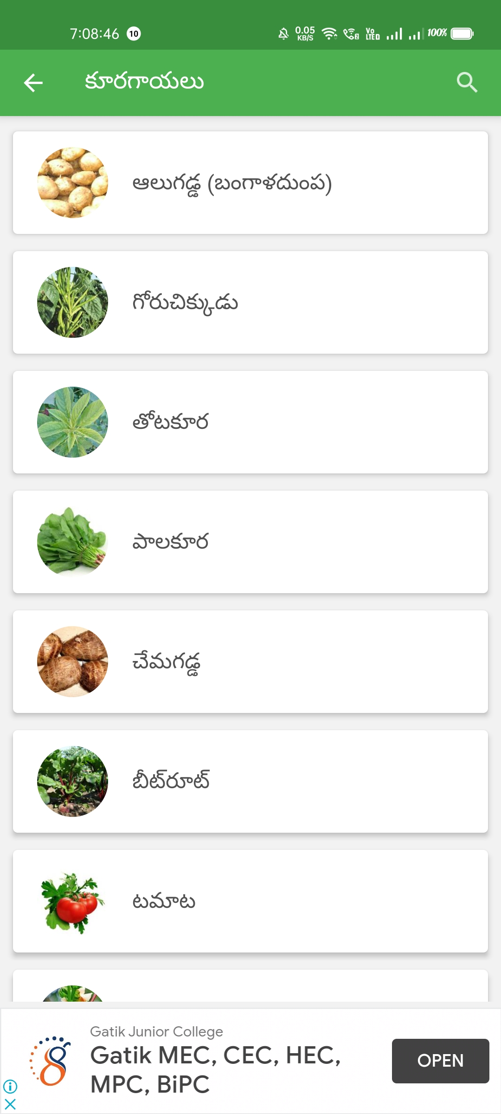
Vyavasayam Telugu Farmers App
Vyavasayam app provides information about Agriculture Crops in Telugu. Information on “How to grow Crops" is provided.
GAPS:
There is no option to select a language, the app opens with the Telugu language by default.
The farmers can’t choose the crops based on some criteria such as pH, season, water, soil type.
No customer services are available.

Slide 11
Research Objective
Notes:
11

Slide 12

Research objective
More than 28 farmers die by suicide in India every day, according to the 2021 State of India’s Environment (SoE) report. One among the main problems facing by many farmers is “FAILURE IN SELECTING THE SUITABLE CROP FOR THEIR LAND”.
Prediction takes time, and selecting the most suitable crop/s is a complex task in agriculture. Manual prediction has largely failed, owing to climatic changes and environmental factors that affect crop cultivation. Accurate predictions of suitable crops for cultivation improve production levels.

Slide 13
Problem Definition
Notes:
13

Slide 14
Problem Definition
To overcome this, we want to develop an website with the factors including season, pH, water level, soil type. When the farmer enters these details as per his requirements he can get all related crops that can be grown in those criteria and by that information he will get an idea regarding which crop has to be grown. We are even providing helpline numbers for those who are illiterates so that they can directly call the helpline numbers and get the required information from them.

Slide 15
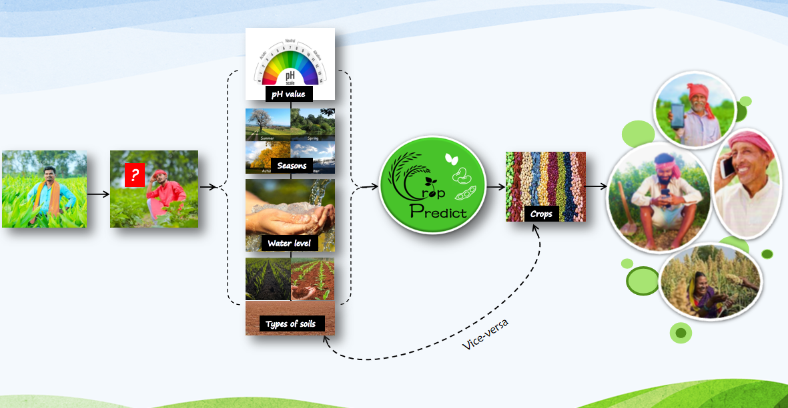
Model

Slide 16
Research Work
Notes:
16

Slide 17
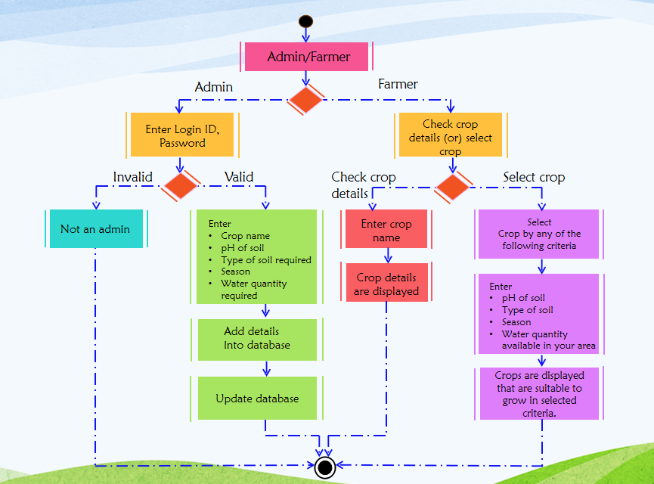
Proposed system architecture

Slide 18


Requirement analysis
Hardware Requirements:
Desktop/Laptop
Internet
Software Requirements:
Sublime Text/Visual Studio Code
XAMPP
Front End Languages:
HTML
CSS
Bootstrap
JavaScript
Back End Languages:
MySQL
PHP

Slide 19
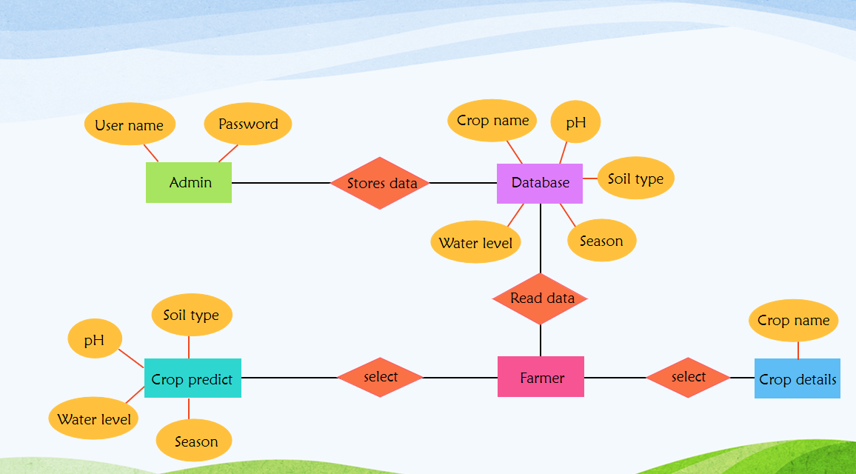
Implementation

Slide 20
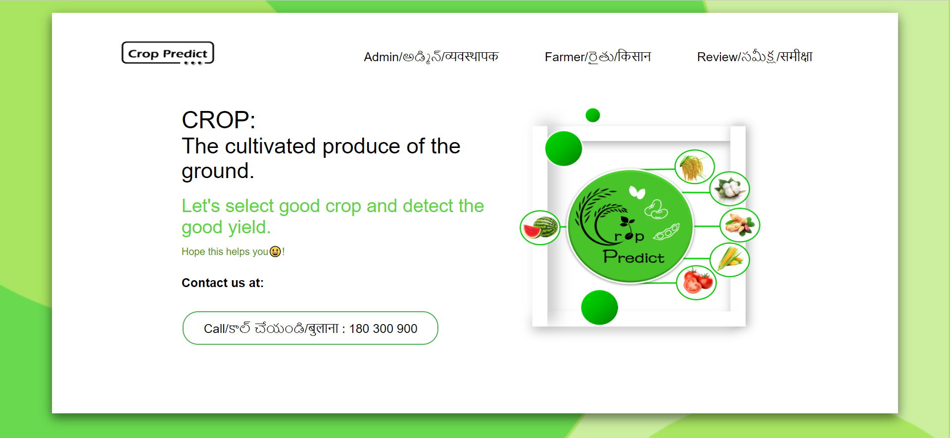

Result Analysis
Fig: Home page
Fig: Admin Login Page

Slide 21
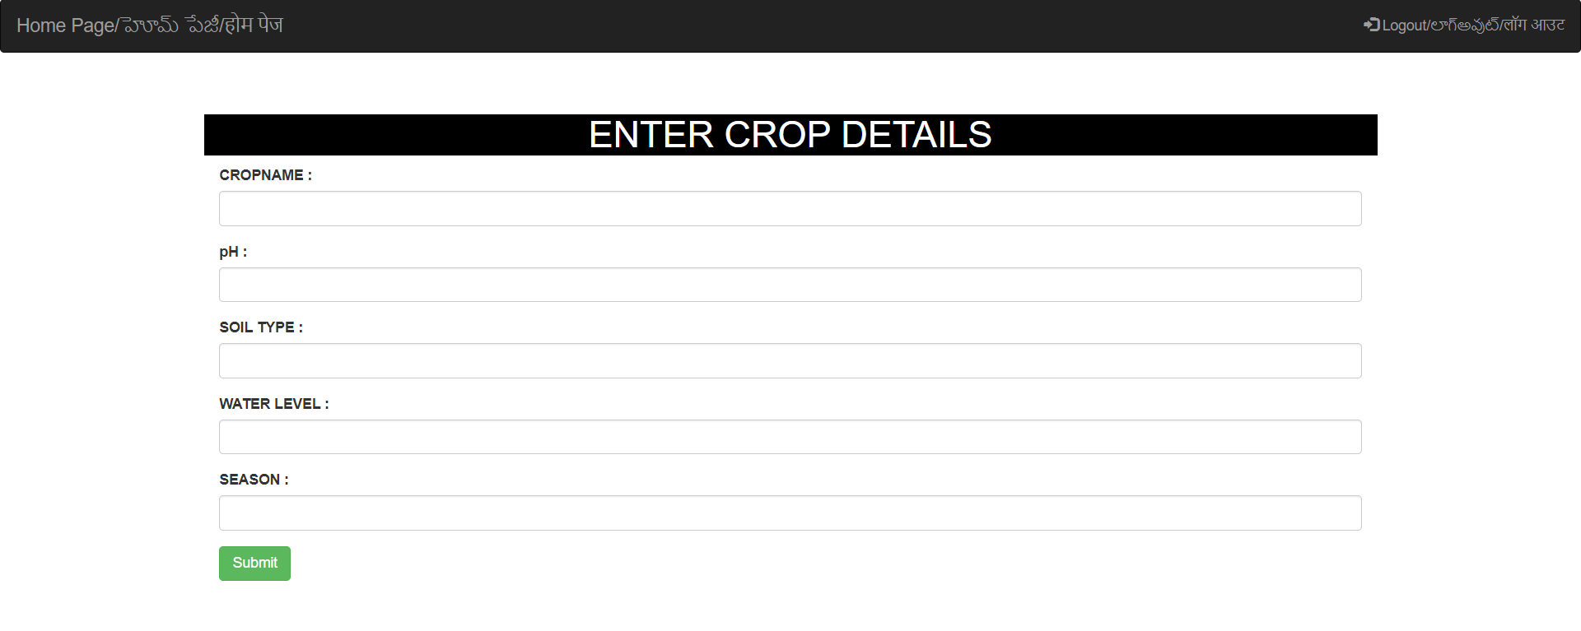
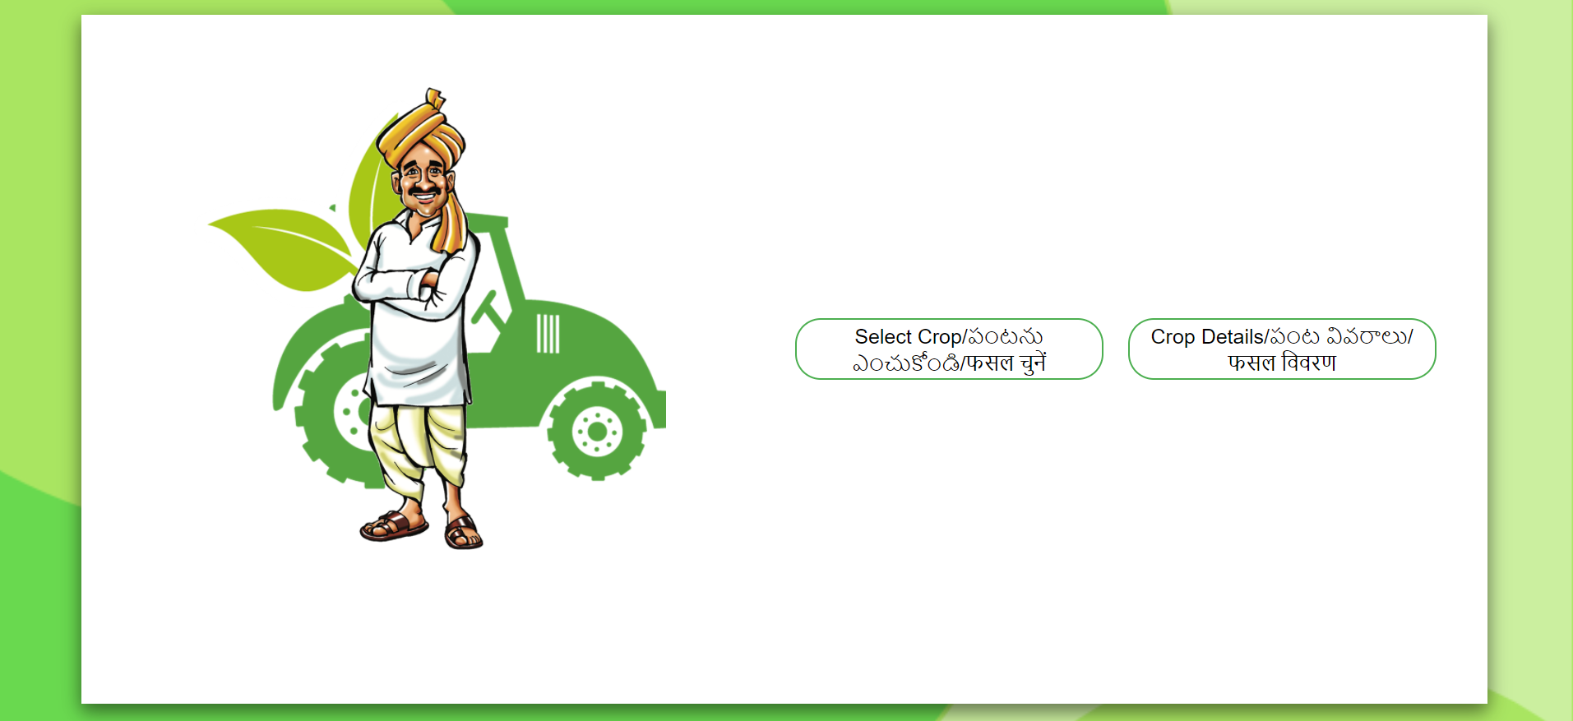
Fig: Upload data into database page
Fig: Farmer Home Page

Slide 22
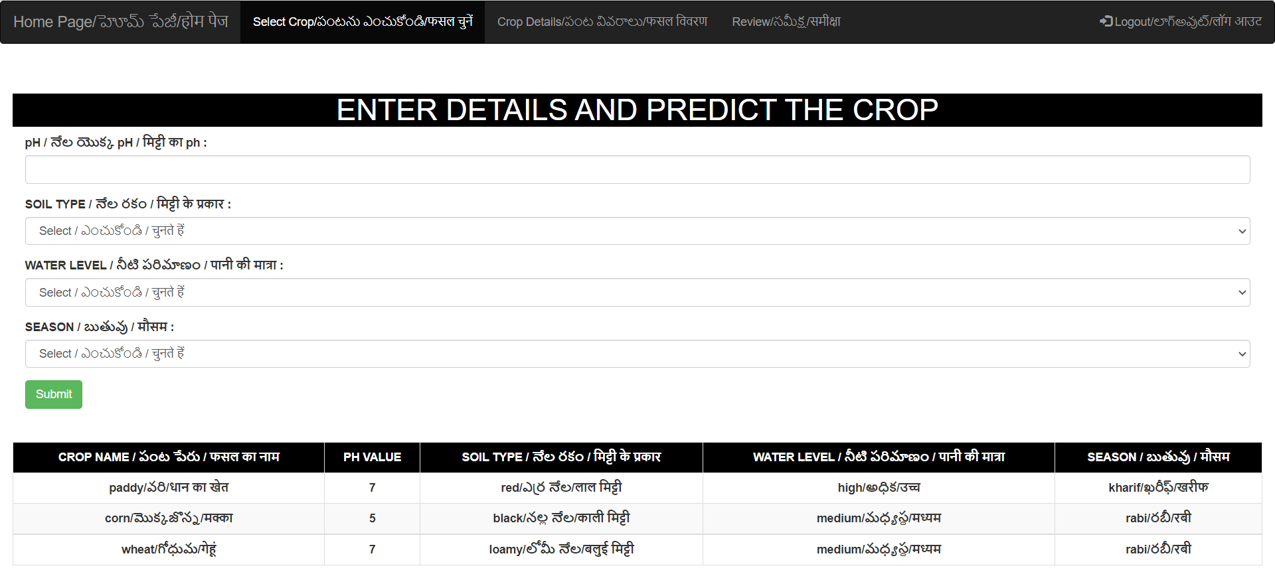
Fig: Select Crop Page

Slide 23
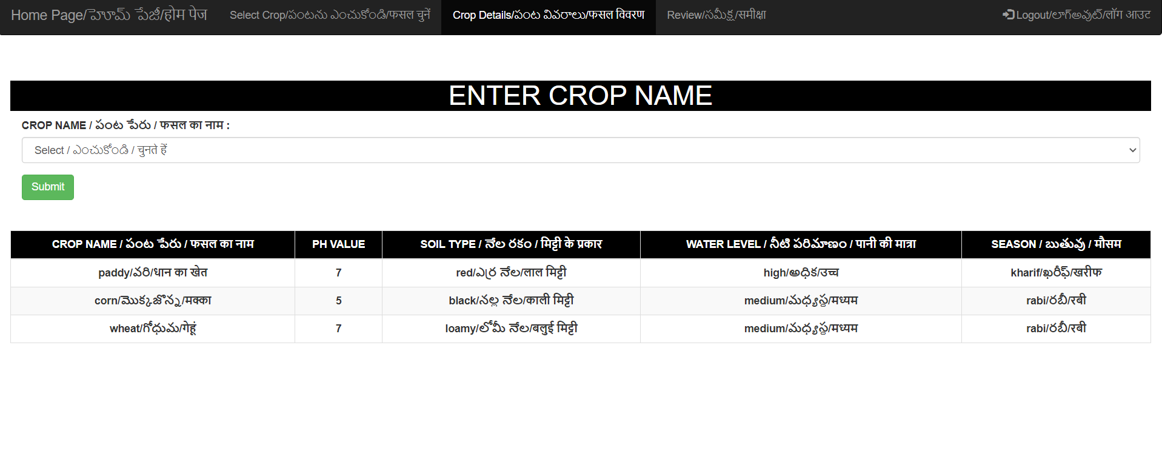
Fig: Crop Details Page

Slide 24
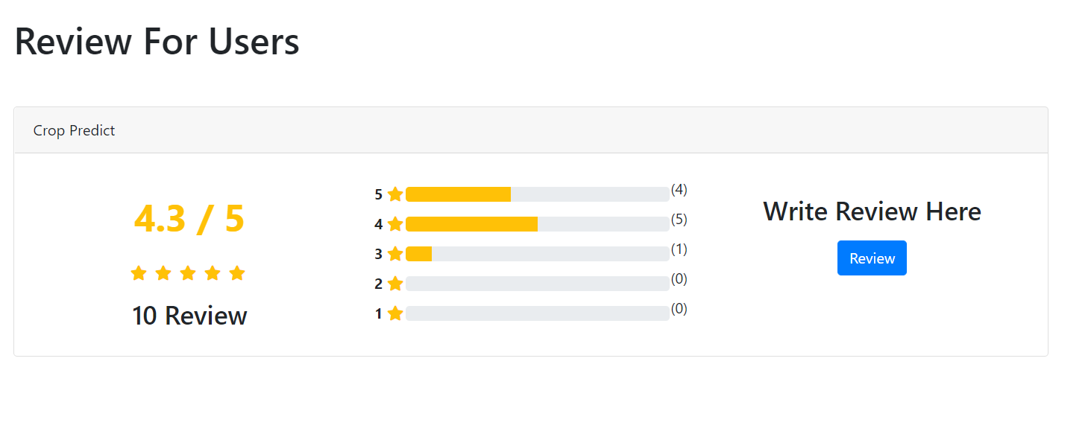
Fig: Review Page

Slide 25

Conclusion
This website helps farmers who are unable to choose a good crop. Usually, farmers take well-wishers suggestions and start cultivation. This may or may not result in a good yield. Many farmers are facing problems because of failure in selecting crops for their land. Confusion or no knowledge about crop yield can be eradicated with this platform.

Slide 26
Future work
This website can be converted into app.
Many new varieties of crops are coming into market, so when admin enter the requirements of new varieties into database then we can add a notification of newly added crop details so that farmers can know about new varieties of crops and their requirements.

Slide 27
References
https://www.downtoearth.org.in/blog/agriculture/state-of-india-s-environment-why-farmers-kill-themselves-75648
https://www.bharatagri.com/
https://play.google.com/store/apps/details?id=com.aci.idss&hl=en_IN&gl=US
https://play.google.com/store/apps/details?id=com.saiuniversalbookstore.vyavasayam&hl=en_IN&gl=US

Slide 28
Thank You!

